Slide 1
Bio& 242, Human A&P 2
Unit 1/Lecture 5

Slide 2
Overview of Energy and Metabolism
The food we eat (carbohydrates, lipids, proteins, and nucleic acids) are our only source of energy for doing the biological work of cells.
All molecules (nutrient molecules included) have stored (potential) energy in the bonds between their atoms.
The energy that runs most biological systems on earth comes from solar energy
Plants trap solar energy via the metabolic reactions of photosynthesis by producing these molecules

Slide 3
Overview of Energy and Metabolism
Terms
Calorie: basic unit of measurement of energy in biological system. Indicated by a “c”
In human metabolism, Calorie is really a kilocalorie or 1,000 calories. Indicated by a “C”
This calorie “C” is the amount of energy required to raise the temperature to 1 kg of water 1 degree C.
The caloric needs of most organisms is measured as Basal Metabolic Rate (BMR)

Slide 4
Overview of Energy and Metabolism
Terms
BMR is the minimum resting energy expenditures by an awake alert person
Average BMR: 70 C/hr or 1680 C/day
If we assume that average amounts of carbohydrates, lipids and proteins are being catabolized, we can calculate a ratio of 4.825 “C” per liter of O2 consumed.
BMR is influenced by age, gender, physical condition, body weight and genes.

Slide 5
Three Basic Uses of Nutrients Absorbed by the Digestive System
1. Energy for immediate use by cells to conduct their normal metabolic processes (muscle contraction, secretions, active transport)
2. Synthesize structural or functional molecules to repair and replace cells.
(Mitosis and Cytokinesis)
3. Storage as glycogen or fat for later use as energy (nutrient reserves)

Slide 6
ALL Living Things from Bacteria to Humans Conduct METABOLISM
Metabolism is the ability to acquire and use energy from the environment.
Metabolic processes are all the chemical reactions that occur in cells, tissues, organs, and organ systems.
Two Kinds of Metabolic Reactions:
Catabolism = breakdown of large molecules into simple ones to produce energy. (release energy)
Anabolism = build large molecules from simple molecules. (requires energy input)

Slide 7
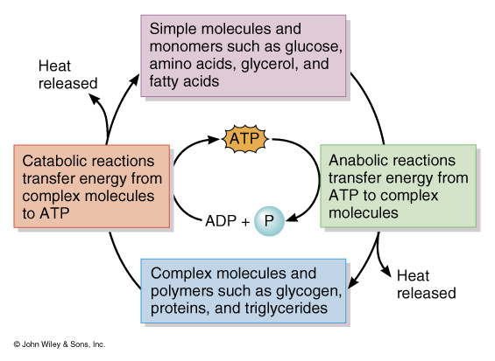
Two Basic Kinds of Chemical Reactions found in Biological System

Slide 8
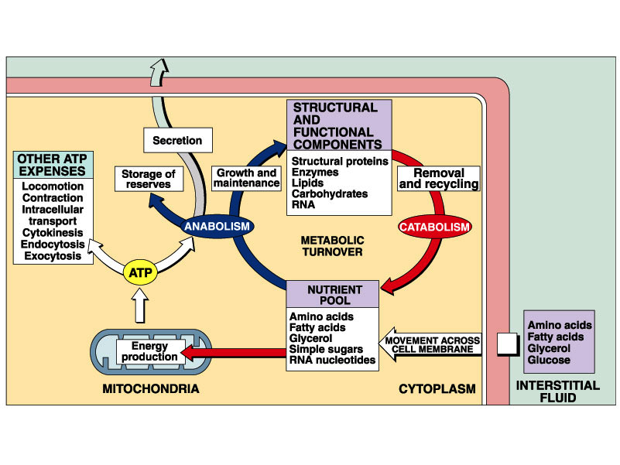
Metabolic Turnover and
Cellular ATP Production

Slide 9
Carbohydrate Metabolism
Amino acid synthesis: Convert pyruvic acid into an Amino Acid requires a transamination
Transamination: Pyruvic Acid + NH3 Amino Acid
Glycogenesis: glucose glycogen
Lipogenesis: glucose triglyceride
Glycogenolysis: glycogen glucose
Gluconeogenesis: lactic acid, amino acids, or triglycerides glucose

Slide 10
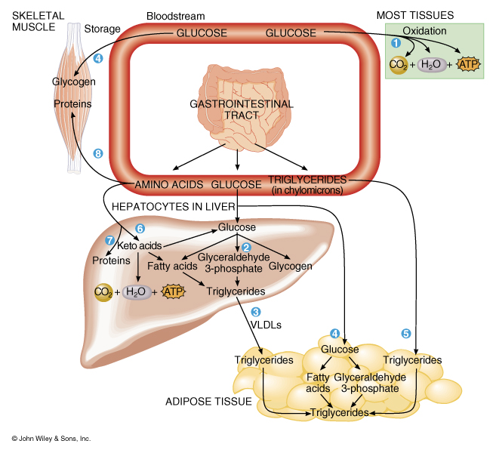
Summary of Glucose Metabolism

Slide 11
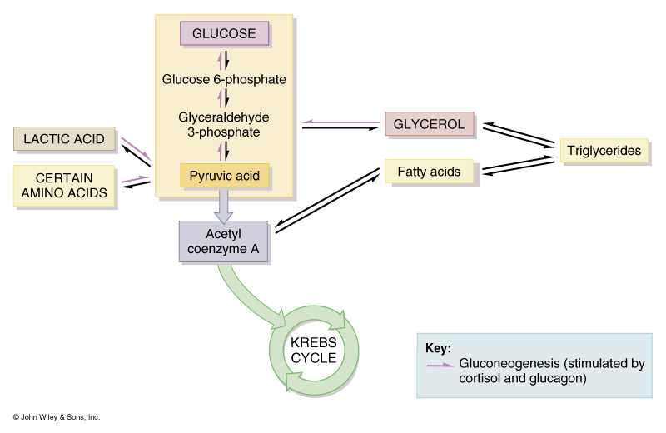
Summary of Gluconeogenesis

Slide 12
ATP production from Carbohydrates
Glycolysis
Substrates required: Glucose, 2 ATP, 4 ADP,
and 2 NAD+
Intermediate Reactants: Glucose-6-phosphate, Fructose-1,6 bisphosphate
Products: 2 molecules of Pyruvic Acid
2 ATP
2 NADH

Slide 13
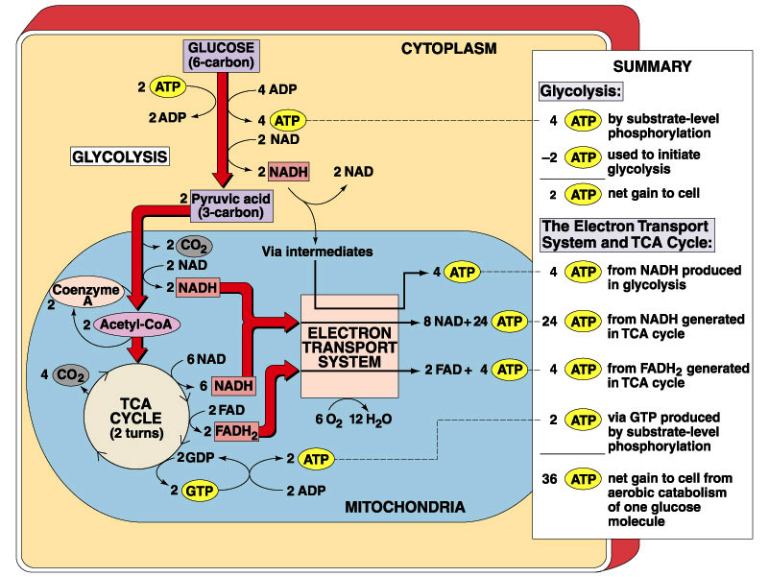
Overview of Cellular Respiration

Slide 14
ATP production from Carbohydrates
Formation of Acetyl-CoA
Substrates required: 2 Pyruvic Acid
2 NAD+
2 Coenzyme A
Products: 2 Acetyl-CoA
2 NADH
2 CO2

Slide 15
Overview of Cellular Respiration

Slide 16
ATP production from Carbohydrates
Kreb’s cycle
Substrates required: 2 Oxaloacetic Acid
2 Acetyl-CoA
6 NAD+
2 FAD
2 GDP
Intermediate Reactants: Citric Acid

Slide 17
ATP production from Carbohydrates
Kreb’s cycle
Products: 2 Oxaloacetic Acid
6 NADH
2 FADH2
2 GTP
4 CO2

Slide 18
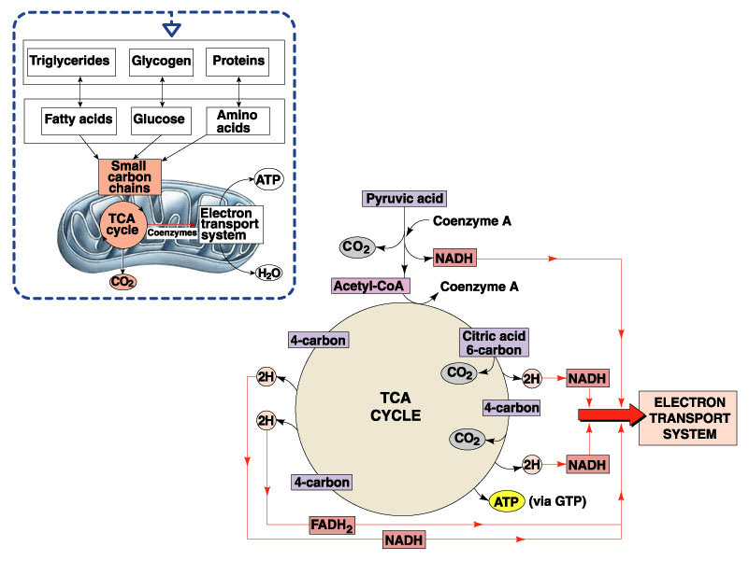
Overview of the Kreb’s Cycle

Slide 19
ATP production from Carbohydrates
Electron Transport Chain
A series of Oxidative Phosphorylation reactions
Oxidation = the removal of electrons from a molecule and results in a decrease in the energy content of the molecule. Because most biological reactions involve the loss of hydrogen atoms, they are called dehydrogenation reactions.
Reduction = the opposite of oxidation; the addition of electrons to a molecule, and results in an increase in the energy content of the molecule.

Slide 20
Overview of Cellular Respiration

Slide 21
ATP production from Carbohydrates
Electron Transport Chain
Substrates required: 10 NADH
2 FADH
6 O2
Products: 32 ATP
6 H20

Slide 22
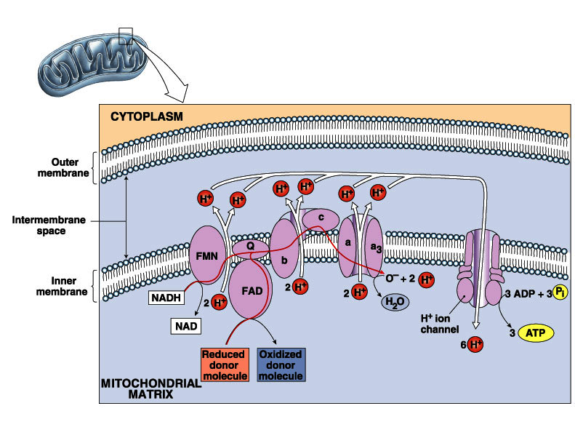
Overview of Electron Transport System

Slide 23
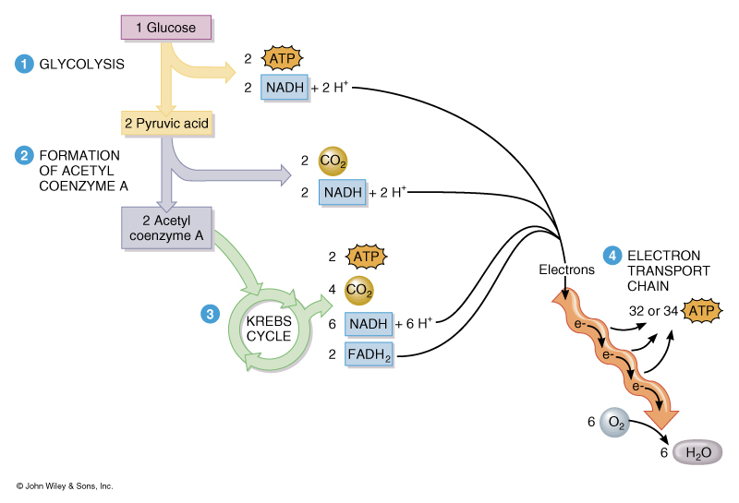
Summary of ATP Production

Slide 24
Protein Metabolism
Deamination: removal of the amino group (NH2) leaving an acetyl molecule
Transamination: Adding an amino group to pyruvic acid to produce any of the nonessential amino acids
Protein Synthesis: Production of protein molecule using an RNA model.
Protein catabolism: breaking down a protein into individual amino acids.

Slide 25
Lipid Metabolism
Lipoproteins: surrounding triglycerides with apoproteins to make them more transportable in water
  Very low-density lipoproteins (VLDL’s)
  Low-density lipoproteins (LDL’s)
  High-density lipoproteins (HDL’s)
  Lipolysis: break down lipids
  Beta Oxidation: breaking a fatty acid into
  2-carbon compounds
  Lipogenesis: formation of lipids from non-lipids

Slide 26
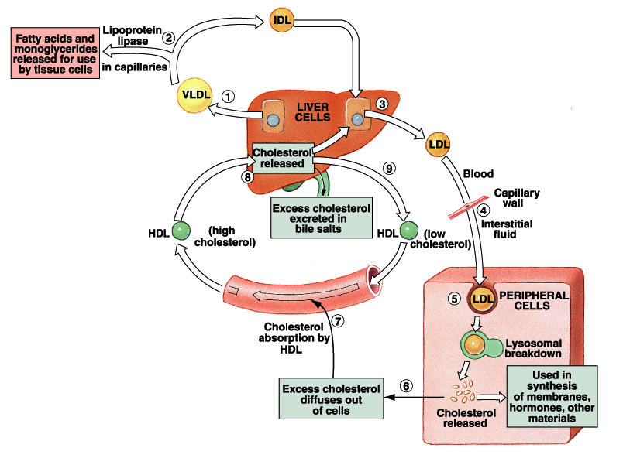
Overview of the Role of the Liver in Lipid Metabolism

Slide 27
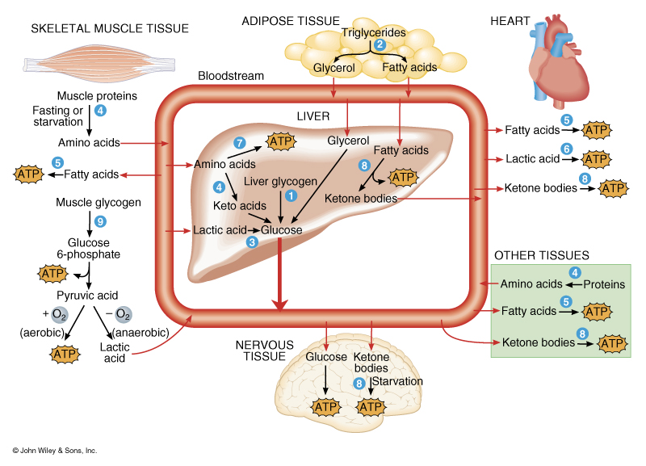
Summary of the Interconnection Between Tissues and Metabolic Reactions

Slide 28
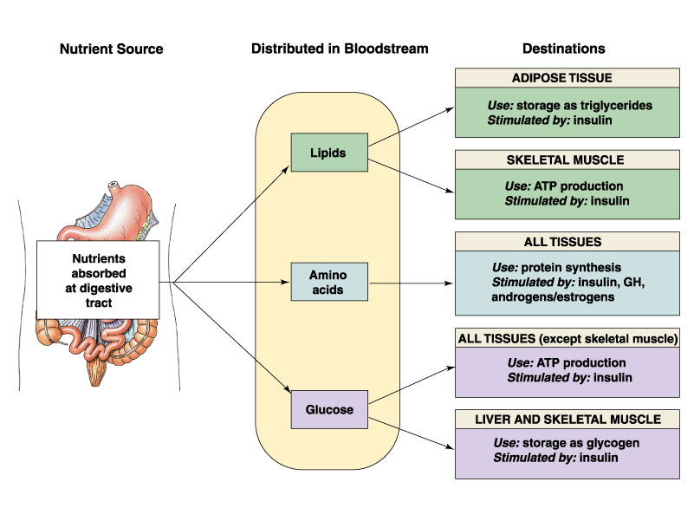
Metabolic Overview:
The Absorptive State

Slide 29
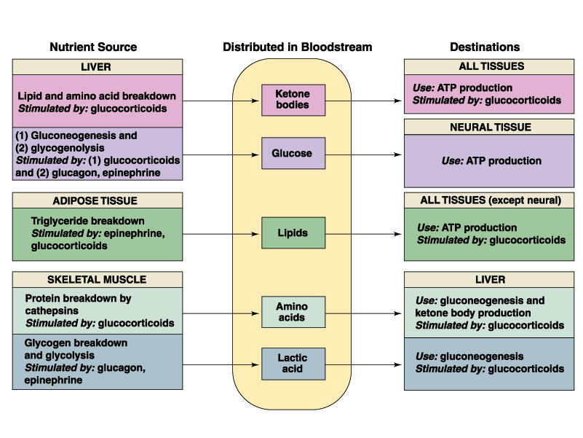
Metabolic overview:
The Post-Absorptive State

